Slide 1
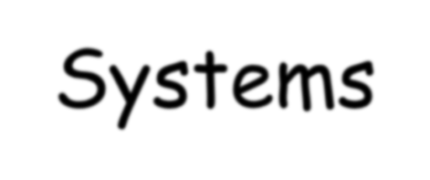
Neural Networks and Fuzzy Systems
Introduction
CSE 0613 4221
Sakurah Ismail
Lecturer, Dept. of CSE NBIU

Slide 2
Introduction
Human and Computer:
Human beings are more intelligent than computers. Why is that said?
Calculating the sum of a few hundred eight and nine digit numbers
Does that make the computer more intelligent than us?
Consider: crosswords
Some of us are excellent
difficult for a computer
Computers are very bad at performing simple visual tasks.

Slide 3
Introduction
Human and Computer:
After 30 years of high-quality research, are not sufficient to allow them to make the claim that they have computer systems that are artificially intelligent in any general sense that we would recognize.
The aim of artificial intelligence could be summed up as trying to make computers behave as they do in the movies.

Slide 4
Introduction
Human and Computer:
Why then can’t computers do the things that we do?
The nature of their design
Brain: slow, highly parallel; Computer: high-speed,
serial machine
Counting is an essentially serial activity (Computer winner)
vision or speech recognition (Brain Winner)
[Note: Computers are designed to carry out one instruction after another, extremely rapidly, whereas our brains work with many more slower units. Whereas a computer can typically carry out a few million operations every second, the units in the brain respond about ten times per second.]

Slide 5
Introduction
For Computer:
Represent Complex information
Design Learning Algorithm
Find the technique of parallel processing

Slide 6
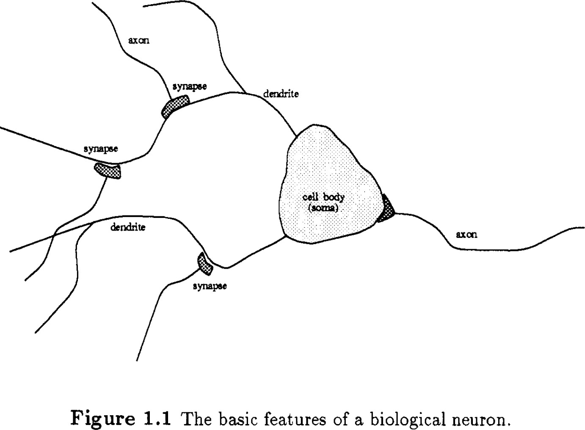
The Structure Of The Brain
The human brain is very complex and not fully understood, but we know it has about 10 billion neurons, each linked to around 10,000 others.
Neurons are tiny processing units that receive signals through dendrites. If enough input is received, the neuron fires a signal.
There are two types: some connect nearby neurons, and others link different brain or body parts.

Slide 7
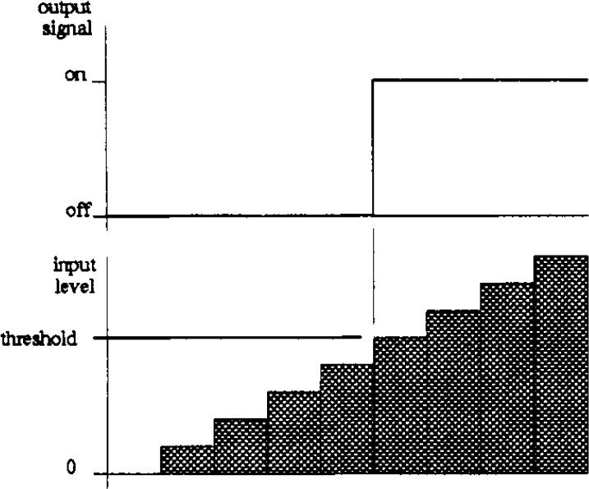
The Structure Of The Brain
The image shows how a neuron works using a threshold.
As the input increases, the neuron
stays "off" until the input goes
(the
above a certain level
threshold).
Once the input is high enough, the neuron turns "on" and sends a signal.
This means a neuron only reacts when the input is strong enough — like a switch that only flips when pushed hard enough.
Fig: The input to the neuron body
must exceed a certain threshold
before the cell will fire.

Slide 8
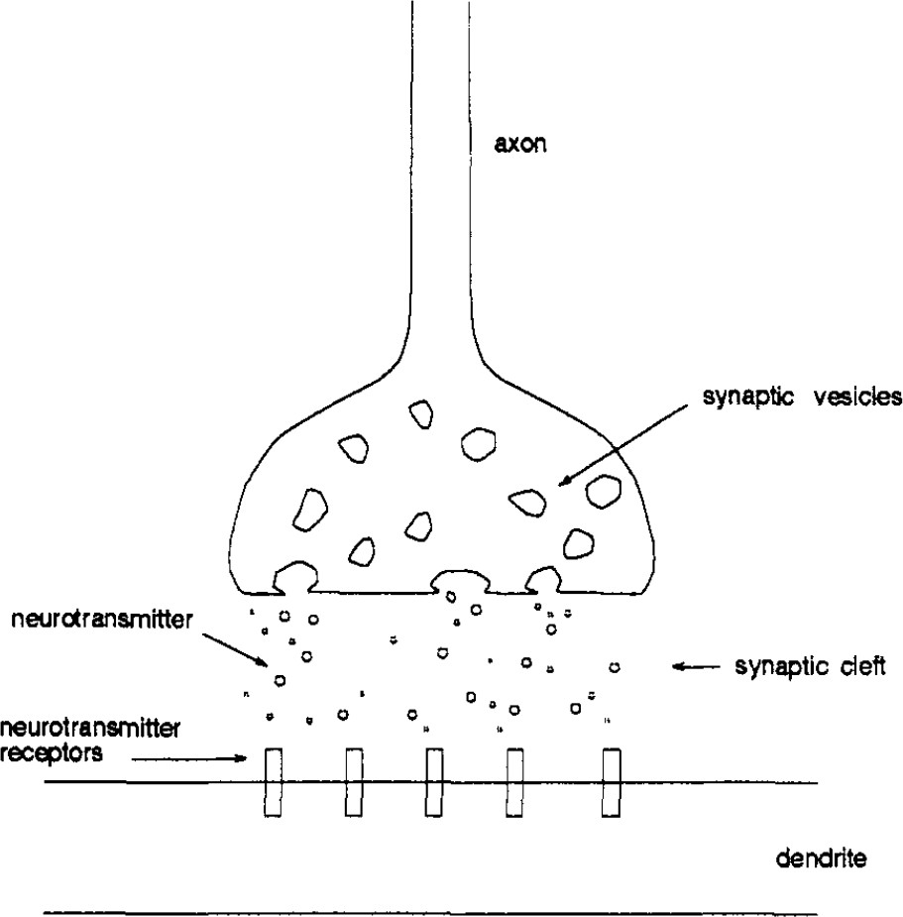
Learning in Biological Systems
When a signal reaches the end of a neuron (the axon terminal), it causes small sacs called synaptic vesicles to release neurotransmitters (chemical messengers).
These chemicals travel across a tiny gap called the synaptic cleft and bind to receptors on the surface of the next neuron's dendrite. This triggers the next neuron to continue the signal.
Fig: How Neurons Communicate at the
Synapse

Slide 9
Biological Neuron | Artificial Neuron
Dendrites receive signals from other neurons. | Inputs (x₁, x₂, ..., xₙ) receive data or signals.
Nucleus processes the signal inside the cell body. | Linear function (z) processes the weighted sum of inputs.
Axon sends the signal to the next neuron. | Output (y) is passed to the next layer or neuron.
Synapse adjusts signal strength between neurons. | Weights (w₁, w₂, ..., wₙ) determine input importance.
Neural firing depends on a threshold. | Activation function (f) decides whether to "fire" (output a value).

Slide 10
Learning In Machines
Learning isn't just something living things do — machines can
learn too.
This challenges the common idea that computers only do what they're told and can't adapt.
While it's true that machines follow programs, they can still behave in ways that seem intelligent by learning from experience.
To explain this, the section talks about a simple learning machine called MENACE (Matchbox Educable Noughts And Crosses Engine), created by Donald Michie in the 1960s.
MENACE learns to play the game of noughts and crosses (tic-tac-toe) using just matchboxes and beads — no fancy technology.

Slide 11
Learning In Machines
Here’s how it works:
MENACE has 288 matchboxes, each representing a different game situation.
Each box has colored beads, with each color representing a possible move.
To make a move, MENACE randomly picks a bead from the box that matches the current game state.
After the game ends, MENACE is updated based on the result:
If it wins, more beads of the successful moves are added (rewarding good moves).
If it loses, beads for the bad moves are removed (punishing bad choices).
If it’s a draw, nothing changes.

Slide 12
Learning In Machines
What's special about MENACE:
It learns from experience, not instructions.
The "knowledge" is not stored in one place, but spread out in the bead choices across all boxes.
It solves the big problem (winning the game) by learning from many small situations.
Even though each matchbox acts alone, together they help the
machine improve.

Slide 13
The Differences
The brain is excellent at tasks like vision, speech, and learning because it uses many simple parts (neurons) working together in parallel. This structure makes it flexible, able to learn, and tolerant of small failures—if some neurons stop working, others take over. This is called fault tolerance and graceful degradation.
In contrast, traditional computers rely on one or a few very fast processors. They are great at simple calculations but are not good at handling complex, varied data like the brain does. If a computer’s processor fails, the whole system often crashes. That’s why scientists are now trying to build computers that work more like the brain: using simple, connected parts that share the work.

Slide 14
Summary
Brain is parallel, distributed processing system.
Basic processing unit called the neuron.
Approximately 10¹⁰ neurons each connected to 10⁴ others.
Operation of neuron: fires pulse down axon when sufficient input received from dendrites. Connections via chemical junctions called synapses.
Learning increases efficacy of synaptic junction.
Machines can learn through positive reinforcement.
Cerebral cortex shows local areas of specialized function.

